Slide 1

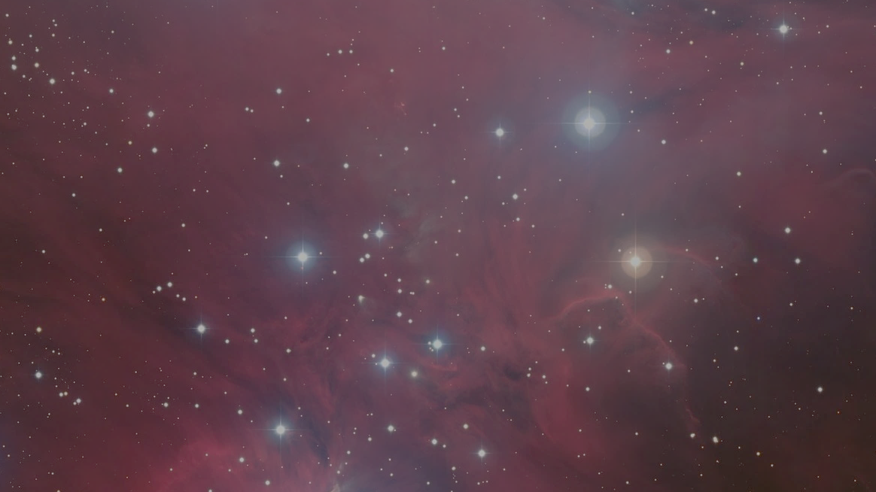


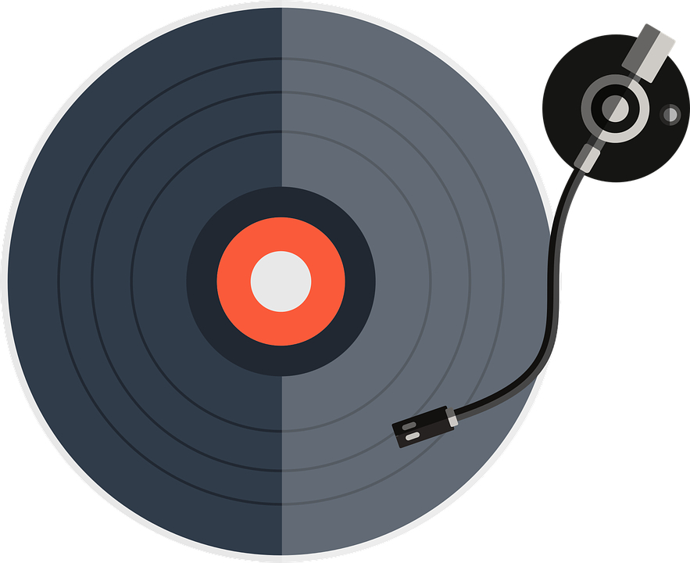
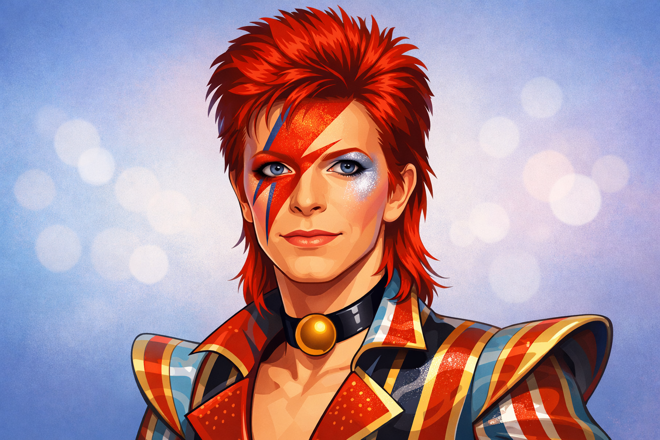
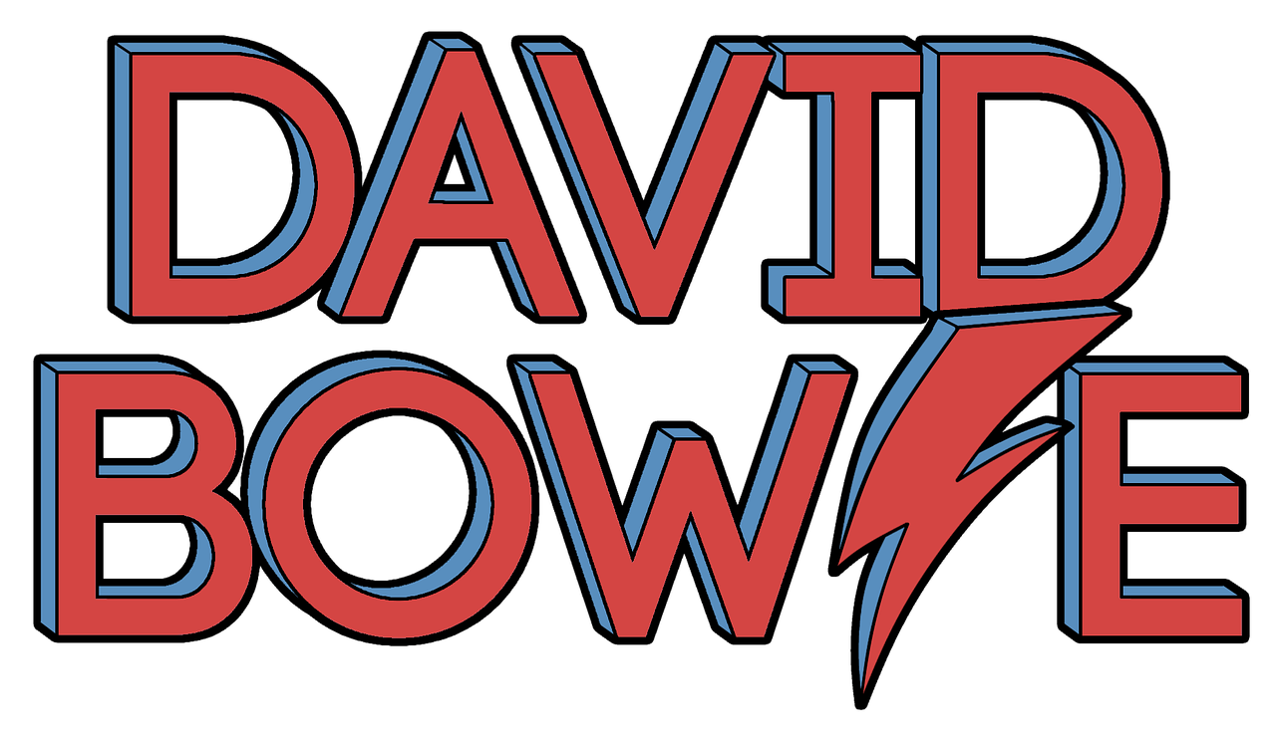

September’s musician is…

Slide 2
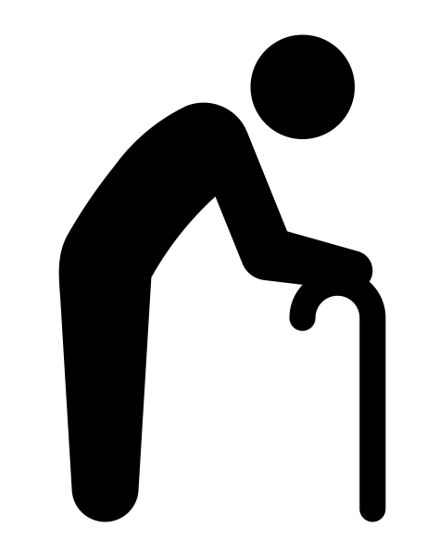
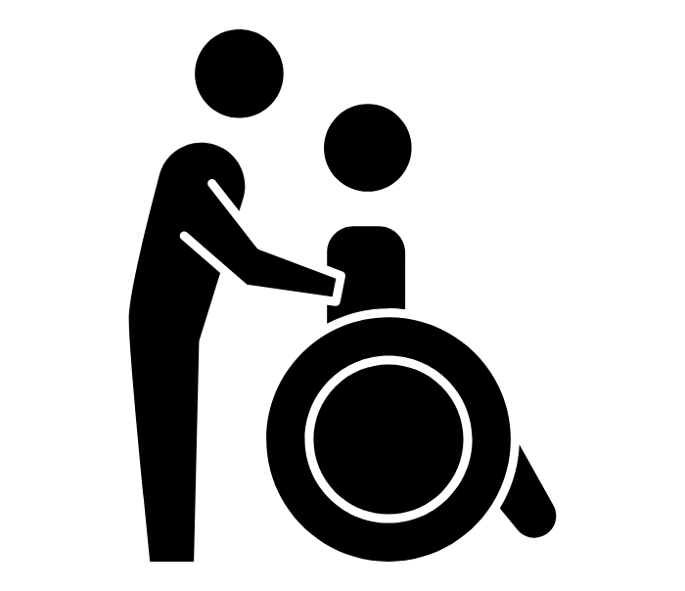
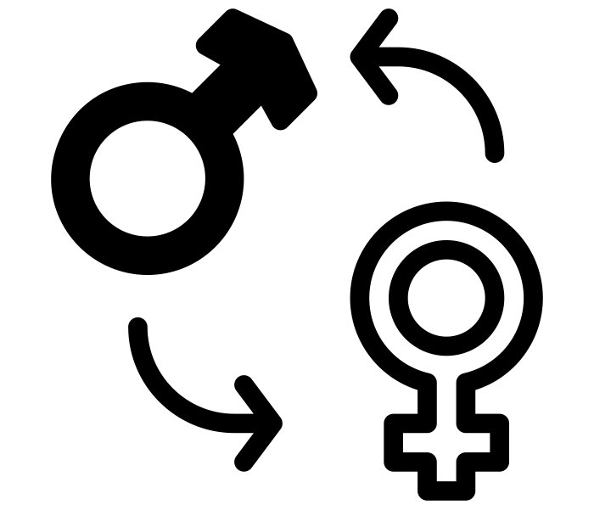




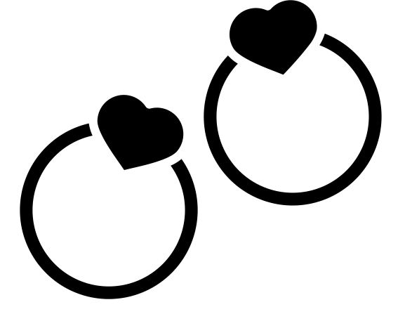
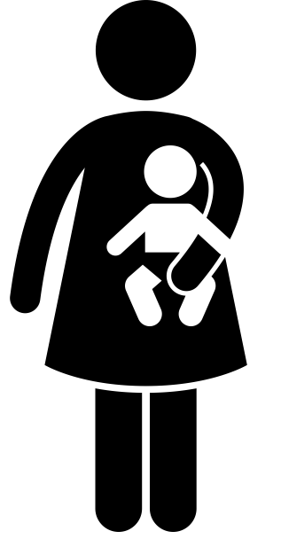
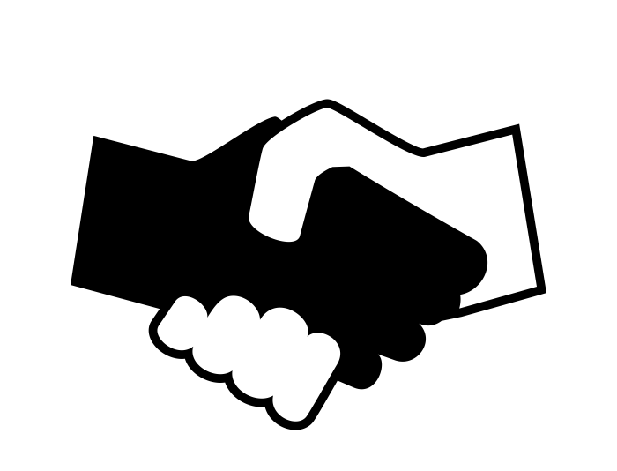

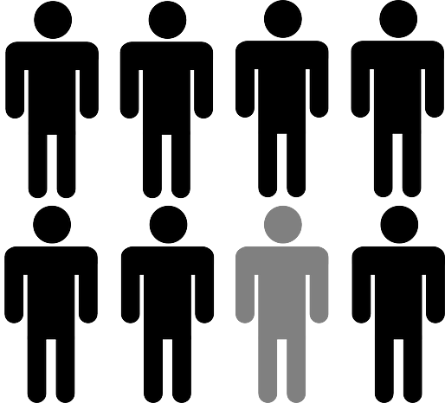
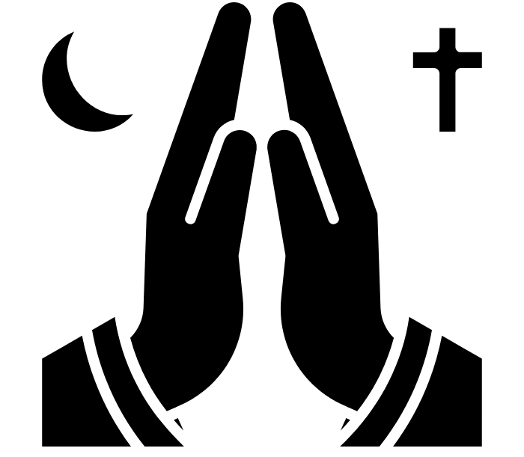
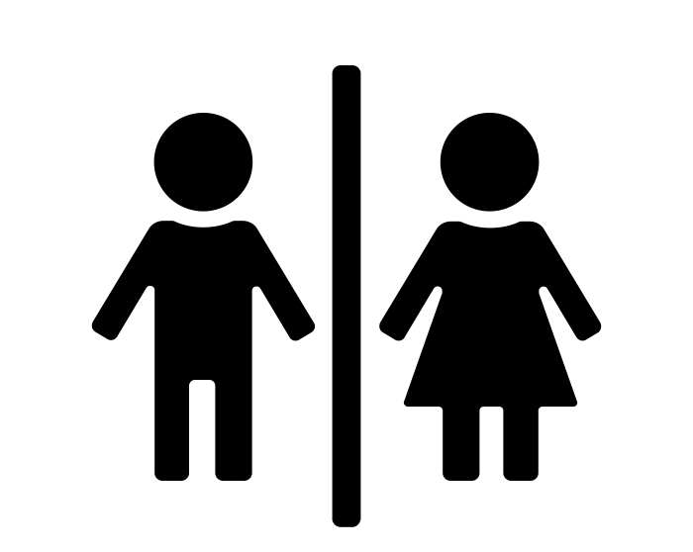
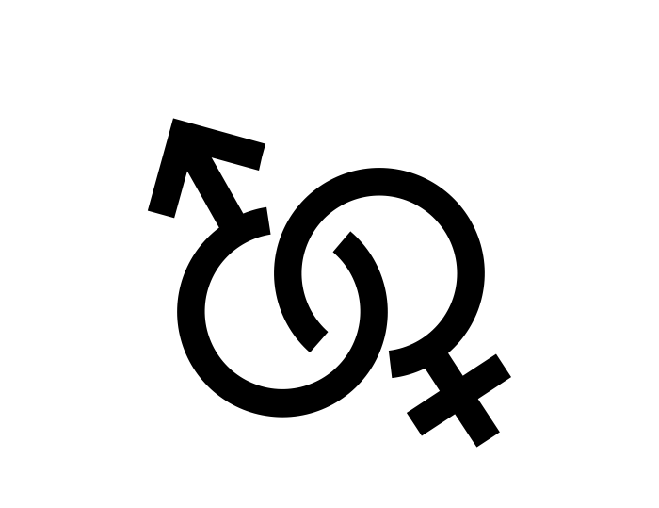
Protected Characteristics (Reminder)
British Values (Reminder)
Age
Disability
Gender
Reassignment
Democracy
The Rule of Law
Individual
Liberty
Marriage /
Civil Partnership
Pregnancy /
Maternity
Race
Mutual Respect
Tolerance
Religion / Beliefs
Sex / Gender
Sexual Orientation
Notes:
Images
"Old Man" icon by David Khai from the Noun Project (https://thenounproject.com/browse/icons/term/old-man/) - CC BY 3.0
“Disability” icon by Lars Meiertoberens from the Noun Project (https://thenounproject.com/icon/disability-6998539/) - CC BY 3.0
“Sex Reassignment” icon by Icogenix from the Noun Project (https://thenounproject.com/icon/sex-reassignment-6440986) - CC BY 3.0
“marriage” icon by Good Wife from the Noun Project (https://thenounproject.com/icon/marriage-6270317) - CC BY 3.0
“mother and baby” by Gan Khoon Lay from the Noun Project (https://thenounproject.com/icon/mother-and-baby-1915190) - CC BY 3.0
“religion belief” by karyative from the Noun Project (https://thenounproject.com/icon/religion-belief-7373321) - CC BY 3.0
“Handshake” by Fiona OM from the Noun Project (https://thenounproject.com/icon/handshake-210064) - CC BY 3.0
“male female” by Nubaia Karim Barsha from the Noun Project (https://thenounproject.com/icon/male-female-2139814) - CC BY 3.0
“sexual orientation” by Worakamon Saykajarn from the Noun Project (https://thenounproject.com/icon/sexual-orientation-3964611) - CC BY 3.0

Slide 3
Introducing David Bowie
The Music of David Bowie
Fun Facts
His Message and Legacy
Question of the Month

Slide 4

Introducing David Bowie
Today, we're going to explore the amazing world of David Bowie, a talented musician, actor and artist.
David Bowie was a musician who was born in London, on January 8th, 1947 and grew up in the area of Brixton.
He was born as David Robert Jones, but he later changed his
name to David Bowie to avoid confusion with another musician.
As a child, David Bowie loved music and art. He would spend
hours playing with different instruments and drawing pictures.

Slide 5
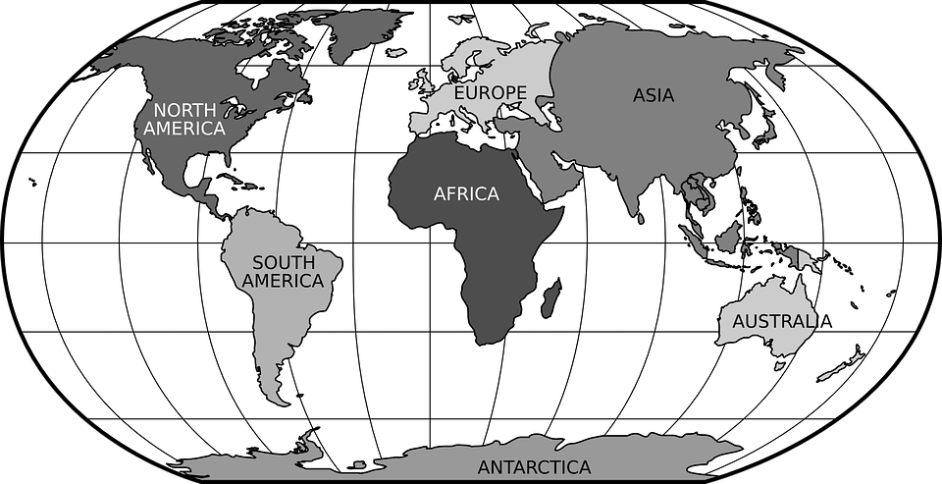
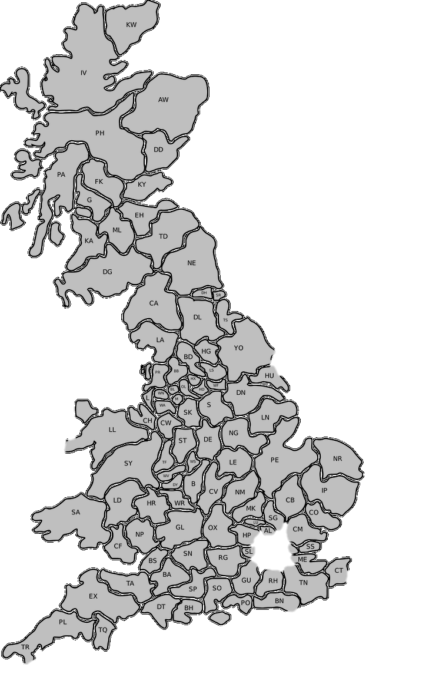

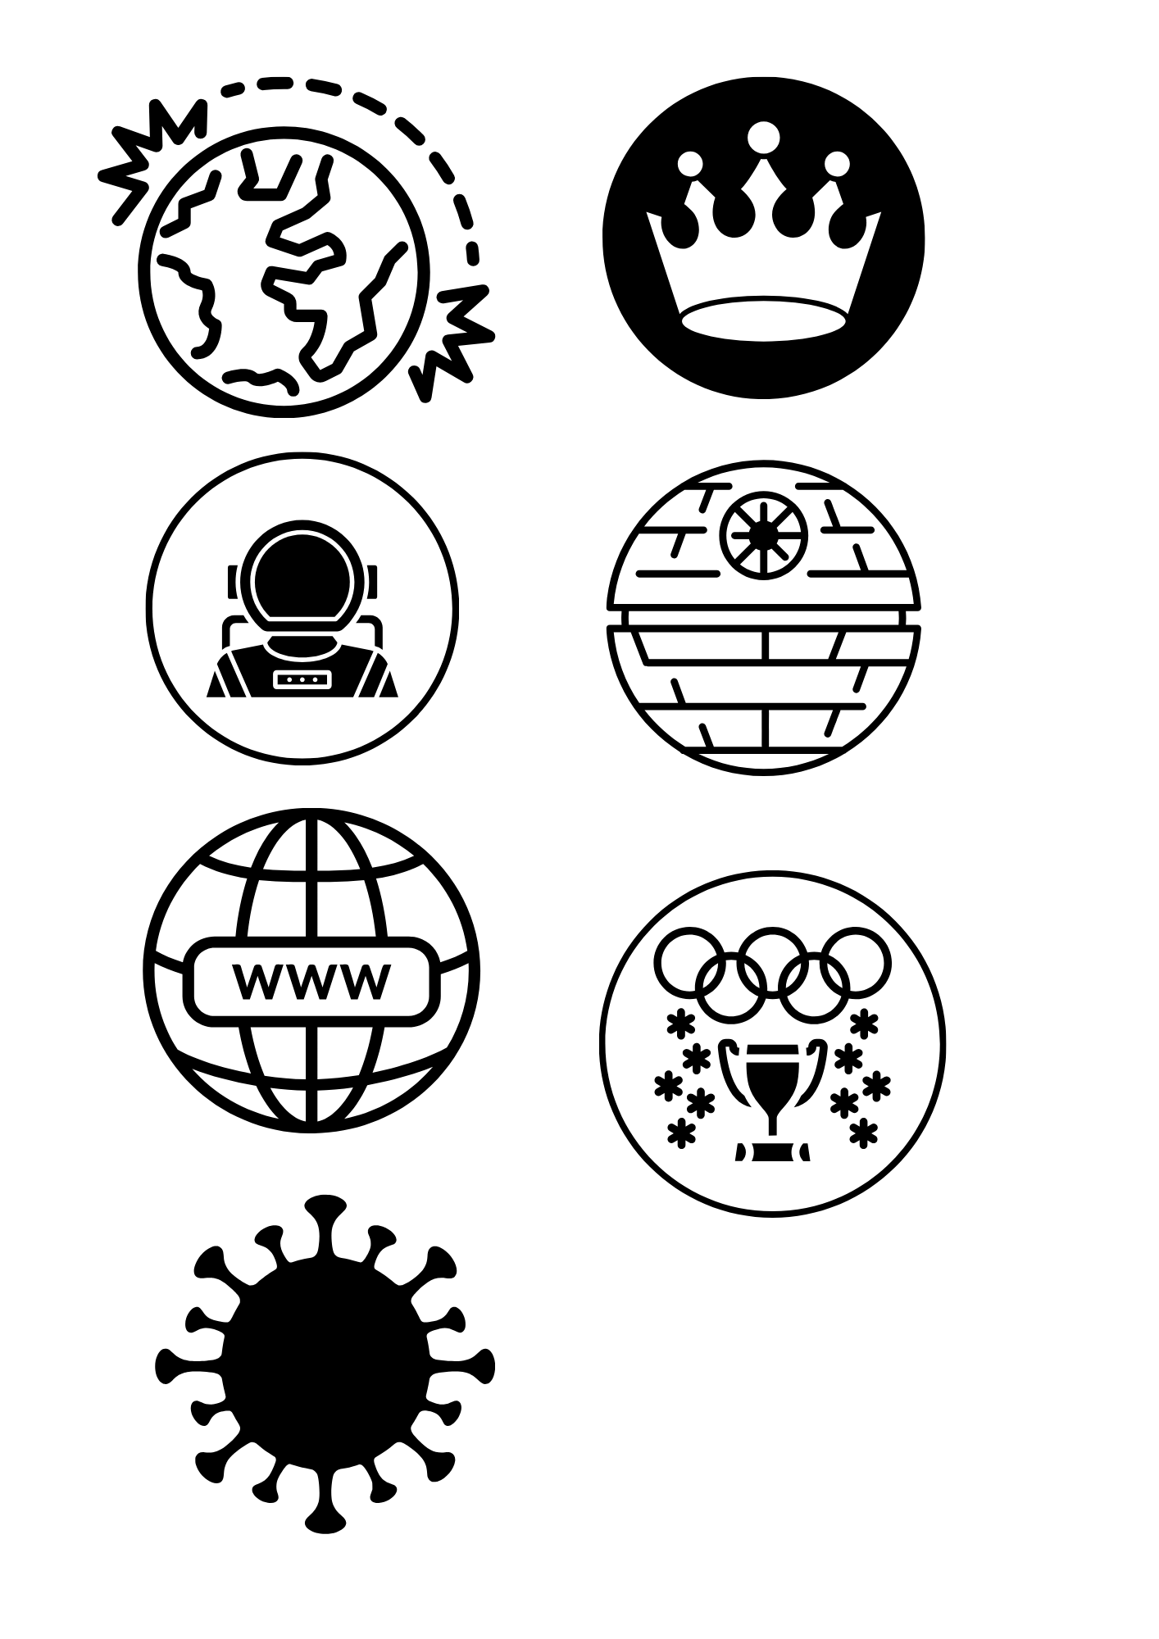
Capital City
(London)
United Kingdom
WWII
(1939-1945)
Bowie is born
(1947)
Elizabeth II becomes Queen
(1953)
Moon landings
(1969)
First Star Wars film released
(1977)
World Wide Web invented
(1990)
London Olympic Games
(2012)
Bowie dies
(2016)
Covid-19
(2019)

Slide 6
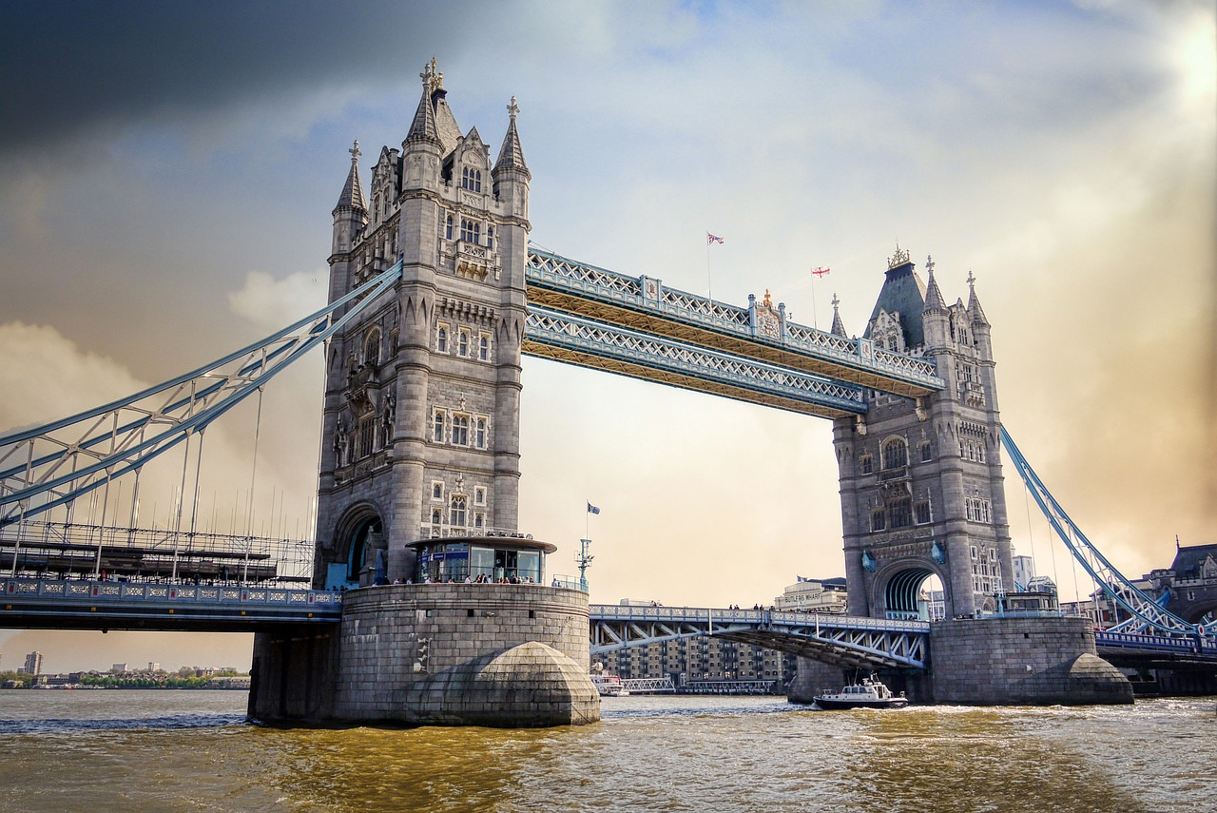

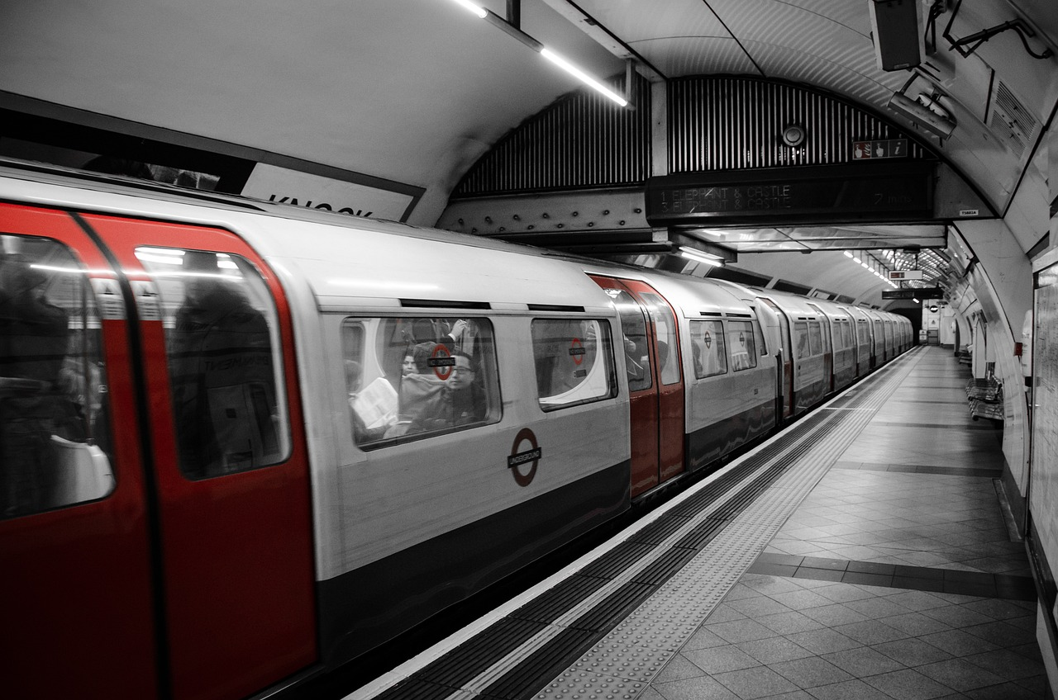
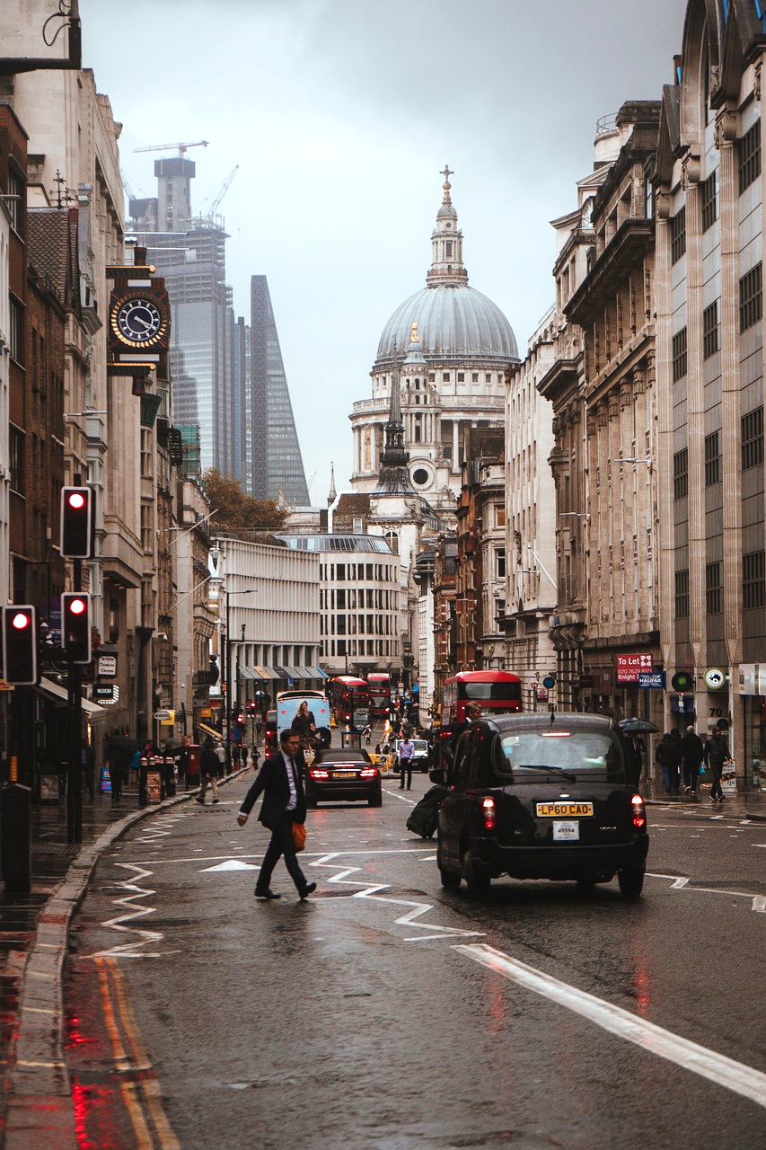
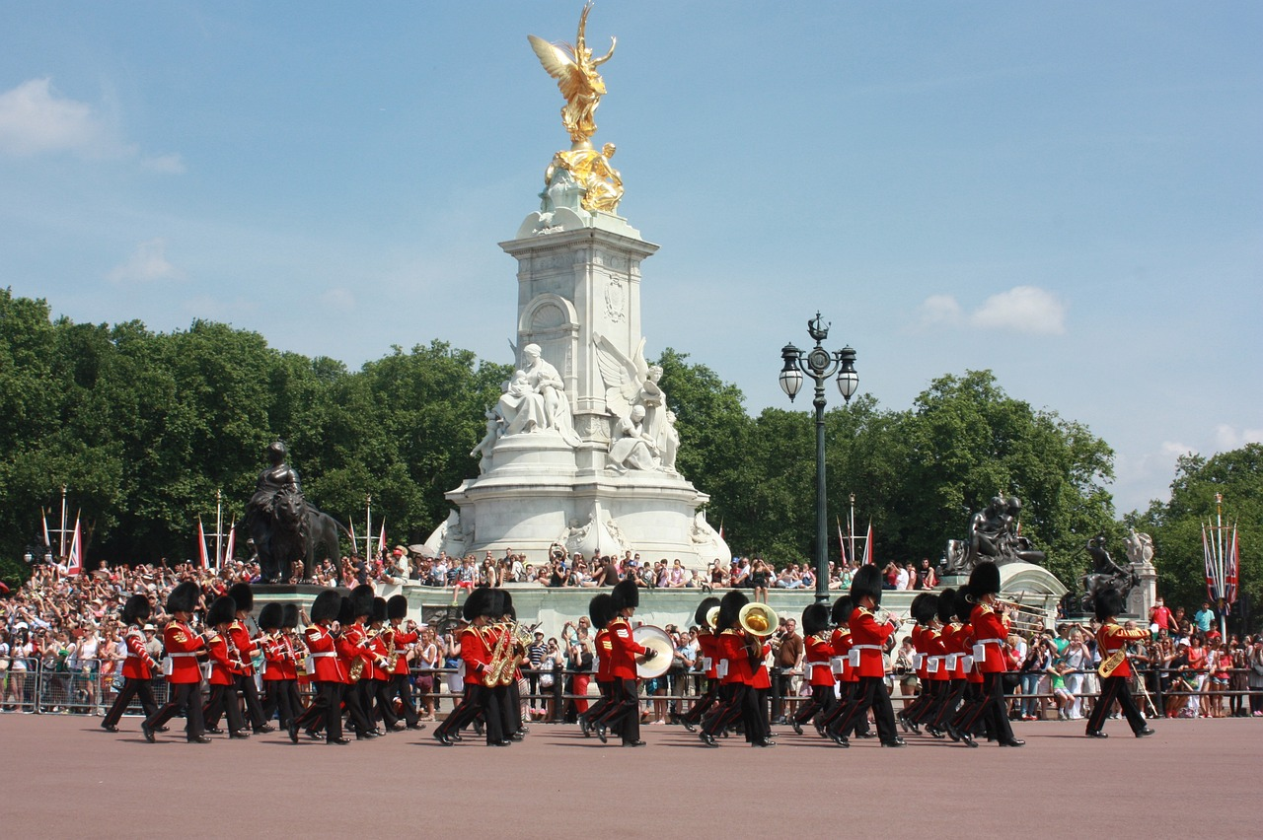


Slide 7

The Music of David Bowie
Bowie was known for his ability to transform himself and create different characters through his music. From Ziggy Stardust to the Thin White Duke, he enchanted audiences with his diverse personalities.
One of Bowie's most famous songs is "Space Oddity,"
which tells the story of an astronaut named Major
Tom. It captured the imaginations of people around
the world during the Space Race and moon landings of 1969.
Bowie was a ‘trendsetter’ in the world of fashion. He
experimented with bold and eccentric outfits, inspiring
generations of artists and fashion enthusiasts.
Click to play
on YouTube
(No Ads)

Slide 8


Fun Facts
Bowie played the role of the Goblin King, in the movie "Labyrinth.“
One of his eye pupils does not dilate so is larger than the other.
He was the first artist to release a ‘CD’.
He created his own internet service in 1998 called
BowieNet and was one of the first artists to embrace
the internet as a way to communicate with fans.

Slide 9
Bowie's impact on music and popular culture remains significant. His music continues to be celebrated and enjoyed by millions of fans worldwide.
His creativity and individuality will forever inspire us to dream big and be true to ourselves. Bowie encouraged people to embrace their uniqueness and express themselves freely.
He taught us that it's okay to be different and that our differences
make us special. He believed people could love who they want
and dress how they like, regardless of gender.
His Message and Legacy

Slide 10
Protected Characteristics
Which ones do you think are best represented by the life of David Bowie?
British Values
Age
Disability
Gender
Reassignment
Democracy
The Rule of Law
Individual
Liberty
Marriage /
Civil Partnership
Pregnancy /
Maternity
Race
Mutual Respect
Tolerance
Religion / Beliefs
Sex / Gender
Sexual Orientation
Notes:
Images
"Old Man" icon by David Khai from the Noun Project (https://thenounproject.com/browse/icons/term/old-man/) - CC BY 3.0
“Disability” icon by Lars Meiertoberens from the Noun Project (https://thenounproject.com/icon/disability-6998539/) - CC BY 3.0
“Sex Reassignment” icon by Icogenix from the Noun Project (https://thenounproject.com/icon/sex-reassignment-6440986) - CC BY 3.0
“marriage” icon by Good Wife from the Noun Project (https://thenounproject.com/icon/marriage-6270317) - CC BY 3.0
“mother and baby” by Gan Khoon Lay from the Noun Project (https://thenounproject.com/icon/mother-and-baby-1915190) - CC BY 3.0
“religion belief” by karyative from the Noun Project (https://thenounproject.com/icon/religion-belief-7373321) - CC BY 3.0
“Handshake” by Fiona OM from the Noun Project (https://thenounproject.com/icon/handshake-210064) - CC BY 3.0
“male female” by Nubaia Karim Barsha from the Noun Project (https://thenounproject.com/icon/male-female-2139814) - CC BY 3.0
“sexual orientation” by Worakamon Saykajarn from the Noun Project (https://thenounproject.com/icon/sexual-orientation-3964611) - CC BY 3.0

Slide 11
Protected Characteristics
This is just what we think. You might have your own opinions too!
British Values
Age
Disability
Gender
Reassignment
Democracy
The Rule of Law
Individual
Liberty
Marriage /
Civil Partnership
Pregnancy /
Maternity
Race
Mutual Respect
Tolerance
Religion / Beliefs
Sex / Gender
Sexual Orientation
Notes:
Images
"Old Man" icon by David Khai from the Noun Project (https://thenounproject.com/browse/icons/term/old-man/) - CC BY 3.0
“Disability” icon by Lars Meiertoberens from the Noun Project (https://thenounproject.com/icon/disability-6998539/) - CC BY 3.0
“Sex Reassignment” icon by Icogenix from the Noun Project (https://thenounproject.com/icon/sex-reassignment-6440986) - CC BY 3.0
“marriage” icon by Good Wife from the Noun Project (https://thenounproject.com/icon/marriage-6270317) - CC BY 3.0
“mother and baby” by Gan Khoon Lay from the Noun Project (https://thenounproject.com/icon/mother-and-baby-1915190) - CC BY 3.0
“religion belief” by karyative from the Noun Project (https://thenounproject.com/icon/religion-belief-7373321) - CC BY 3.0
“Handshake” by Fiona OM from the Noun Project (https://thenounproject.com/icon/handshake-210064) - CC BY 3.0
“male female” by Nubaia Karim Barsha from the Noun Project (https://thenounproject.com/icon/male-female-2139814) - CC BY 3.0
“sexual orientation” by Worakamon Saykajarn from the Noun Project (https://thenounproject.com/icon/sexual-orientation-3964611) - CC BY 3.0

Slide 12
Protected Characteristics
This is just what we think. You might have your own opinions too!
British Values
Age
Disability
Gender
Reassignment
Democracy
The Rule of Law
Individual
Liberty
Marriage /
Civil Partnership
Pregnancy /
Maternity
Race
Mutual Respect
Tolerance
Religion / Beliefs
Sex / Gender
Sexual Orientation
Notes:
Images
"Old Man" icon by David Khai from the Noun Project (https://thenounproject.com/browse/icons/term/old-man/) - CC BY 3.0
“Disability” icon by Lars Meiertoberens from the Noun Project (https://thenounproject.com/icon/disability-6998539/) - CC BY 3.0
“Sex Reassignment” icon by Icogenix from the Noun Project (https://thenounproject.com/icon/sex-reassignment-6440986) - CC BY 3.0
“marriage” icon by Good Wife from the Noun Project (https://thenounproject.com/icon/marriage-6270317) - CC BY 3.0
“mother and baby” by Gan Khoon Lay from the Noun Project (https://thenounproject.com/icon/mother-and-baby-1915190) - CC BY 3.0
“religion belief” by karyative from the Noun Project (https://thenounproject.com/icon/religion-belief-7373321) - CC BY 3.0
“Handshake” by Fiona OM from the Noun Project (https://thenounproject.com/icon/handshake-210064) - CC BY 3.0
“male female” by Nubaia Karim Barsha from the Noun Project (https://thenounproject.com/icon/male-female-2139814) - CC BY 3.0
“sexual orientation” by Worakamon Saykajarn from the Noun Project (https://thenounproject.com/icon/sexual-orientation-3964611) - CC BY 3.0

Slide 13
Protected Characteristics
His Message and Legacy
David Bowie was a man who challenged the usual ideas about how men should look and behave. He showed that men and boys can express themselves in many different ways and still be successful and respected.
Sex / Gender
British values
David Bowie showed that love and creativity can take many forms, and everyone deserves respect for who they are.
Bowie worked with musicians, designers, and performers from many backgrounds, showing respect for their ideas and helping everyone create amazing music and shows together.
Individual
Liberty
Mutual Respect

Slide 14

Question of the Month
Agree
Is it better to fit in or stand out?
Build
Challenge

Slide 15
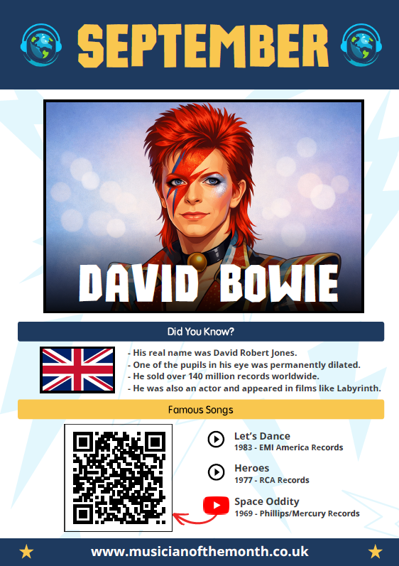
We hope you enjoyed learning about David Bowie and his amazing journey through music (and space), and we hope you enjoy learning even more about him this September!
Remember to keep exploring,
imagining, and embracing your
own unique spirit, just like
Bowie did.

Slide 16


