Slide 1
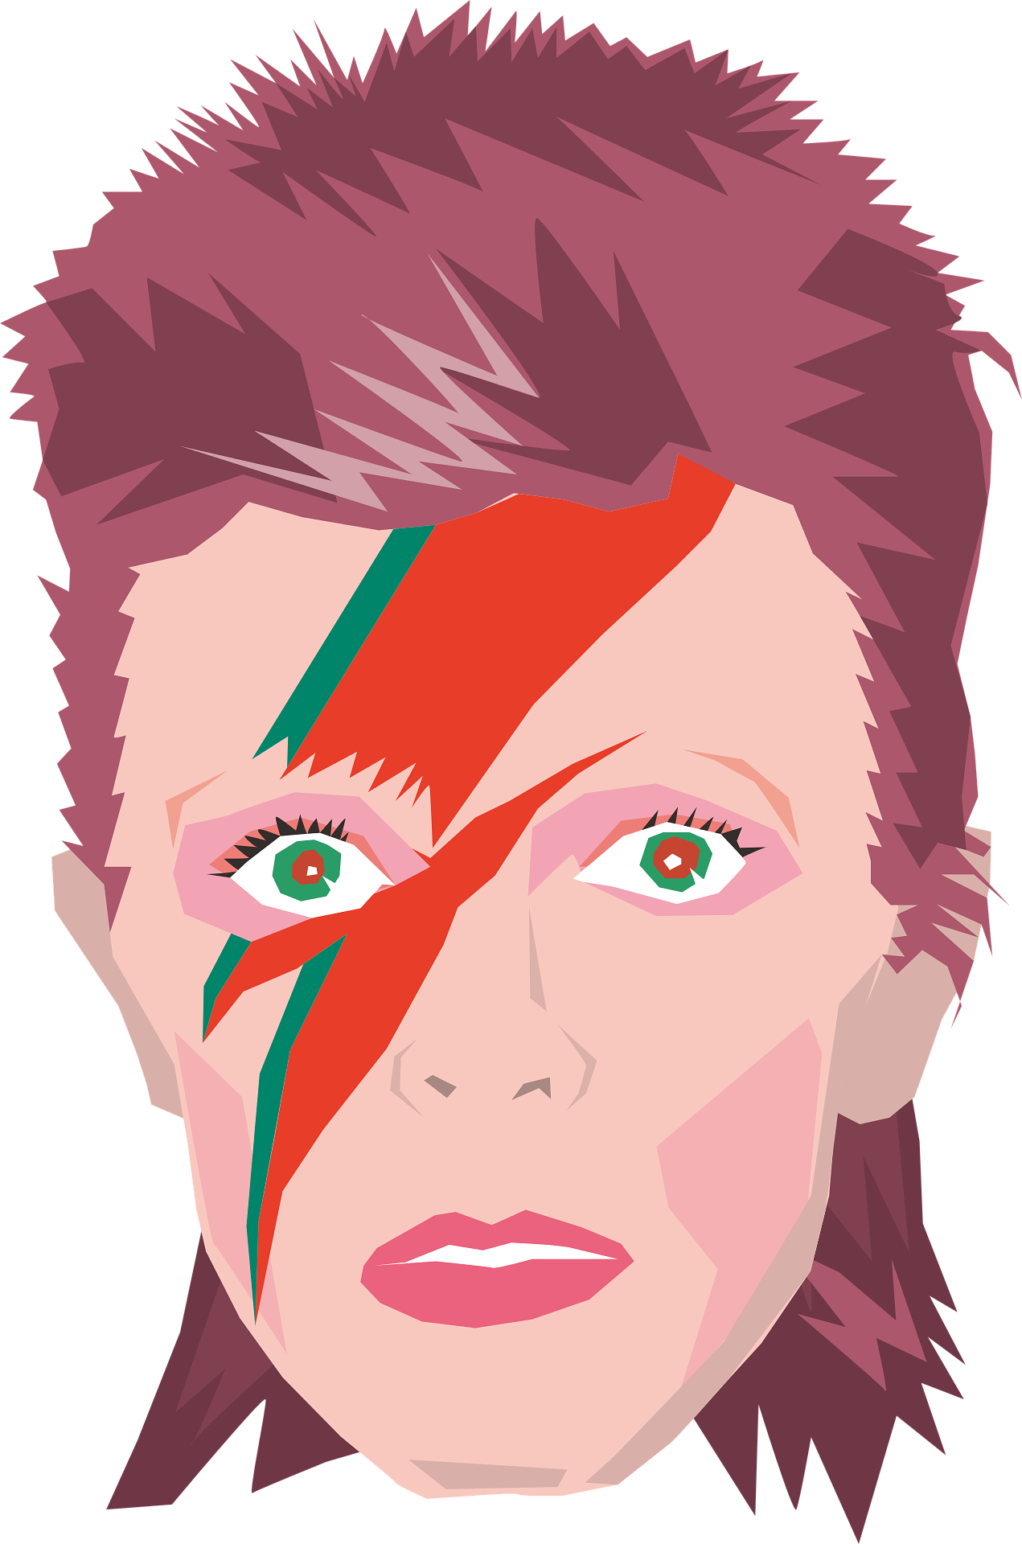
September’s musician is…

Slide 2
Agenda
Introducing David Bowie
The Music of David Bowie
Fun Facts
His Message and Legacy

Slide 3
Introducing David Bowie
Today, we're going to explore the amazing world of David Bowie, a talented musician, actor and artist.
David Bowie was a musician who was born in London, on January 8th, 1947 and grew up in the area of Brixton.
He was born as David Robert Jones, but he later changed his
name to David Bowie to avoid confusion with another musician.
As a child, David Bowie loved music and art. He was always
curious and loved to explore new things. He would spend hours
playing with different instruments and drawing pictures.

Slide 4
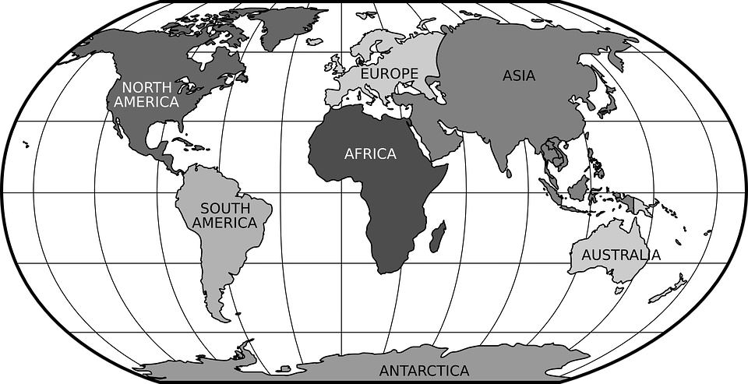
United Kingdom
Capital City (London)

Slide 5
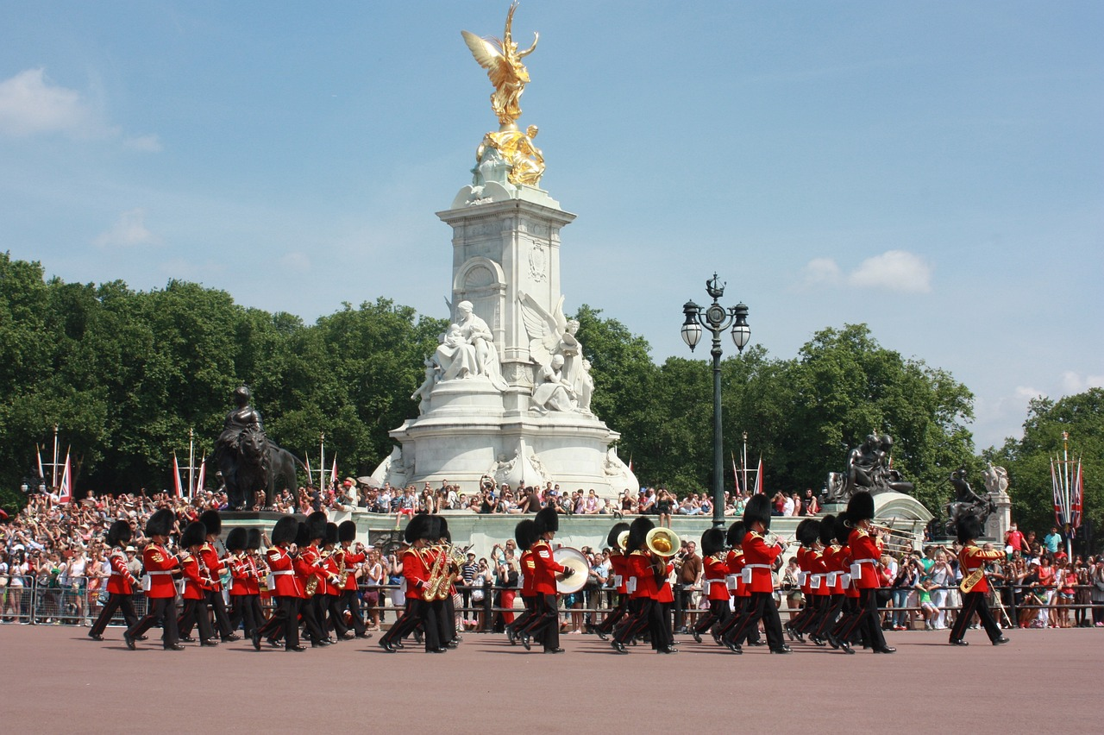

Slide 6
The Music of David Bowie
Bowie was known for his ability to transform himself and create different characters through his music. From Ziggy Stardust to the Thin White Duke, he enchanted audiences with his diverse personas.
One of Bowie's most famous songs is "Space Oddity,"
which tells the story of an astronaut named Major
Tom. It captured the imaginations of people around
the world during the Space Race and moon landings of 1969.
Bowie was a trendsetter in the world of fashion. He experimented
with bold and eccentric outfits, inspiring generations of artists and
fashion enthusiasts.
Click to play
on YouTube

Slide 7
Fun Facts
Bowie played the role of the Goblin King, in the movie "Labyrinth.“
One of his eye pupils does not dilate so is larger than the other.
He was the first artist to release a ‘CD’.
He created his own internet service in 1998 called
BowieNet and was one of the first artists to embrace
the internet as a way to communicate with fans.

Slide 8
His Message and Legacy
Even after his passing in 2016, Bowie's impact on music and popular culture remains significant. His music continues to be celebrated and enjoyed by millions of fans worldwide.
His creativity and individuality will forever inspire us to dream
big and be true to ourselves.
Bowie encouraged people to embrace their uniqueness and
express themselves freely. He taught us that it's okay to be
different and that our differences make us special.

Slide 9
We hope you enjoyed learning a little about David Bowie and his amazing journey through music (and space), and we hope you enjoy learning even more about him this September!
Remember to keep exploring,
imagining, and embracing your
own unique spirit, just like
Bowie did.

